Slide 1
VOICE BASED EMAIL FOR VISUALLY IMPAIRED
PROJECT GUIDE : PROF. SUDHIR BAGADE
BY :
AISHWARYA BELEKAR – 07
NEHA BHAWAR – 08
SHIVANI SUNKA – 43

Slide 2
PROPOSED SYSTEM
We aim to develop a desktop application that can be used by people with various visual imparities, to access emails easily and efficiently.
All the existing voice based email systems, provide their own user developed email services and do not incorporate the use of Google’s Gmail.
So, considering this, we intend to develop our application by linking it with the Gmail Client, thereby giving users an additional advantage.

Slide 3
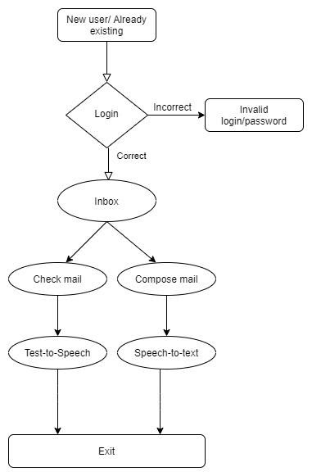
FLOWCHART

Slide 4
IMPLEMENTATION DETAILS
We have added a "application control" feature, that opens applications on the desktop using voice command.
We are working on training the speech recognition part.
The email part we aimed for entirely voice based, but we have had to accompany the use of keyboard and mouse clicks at some points.

Slide 5
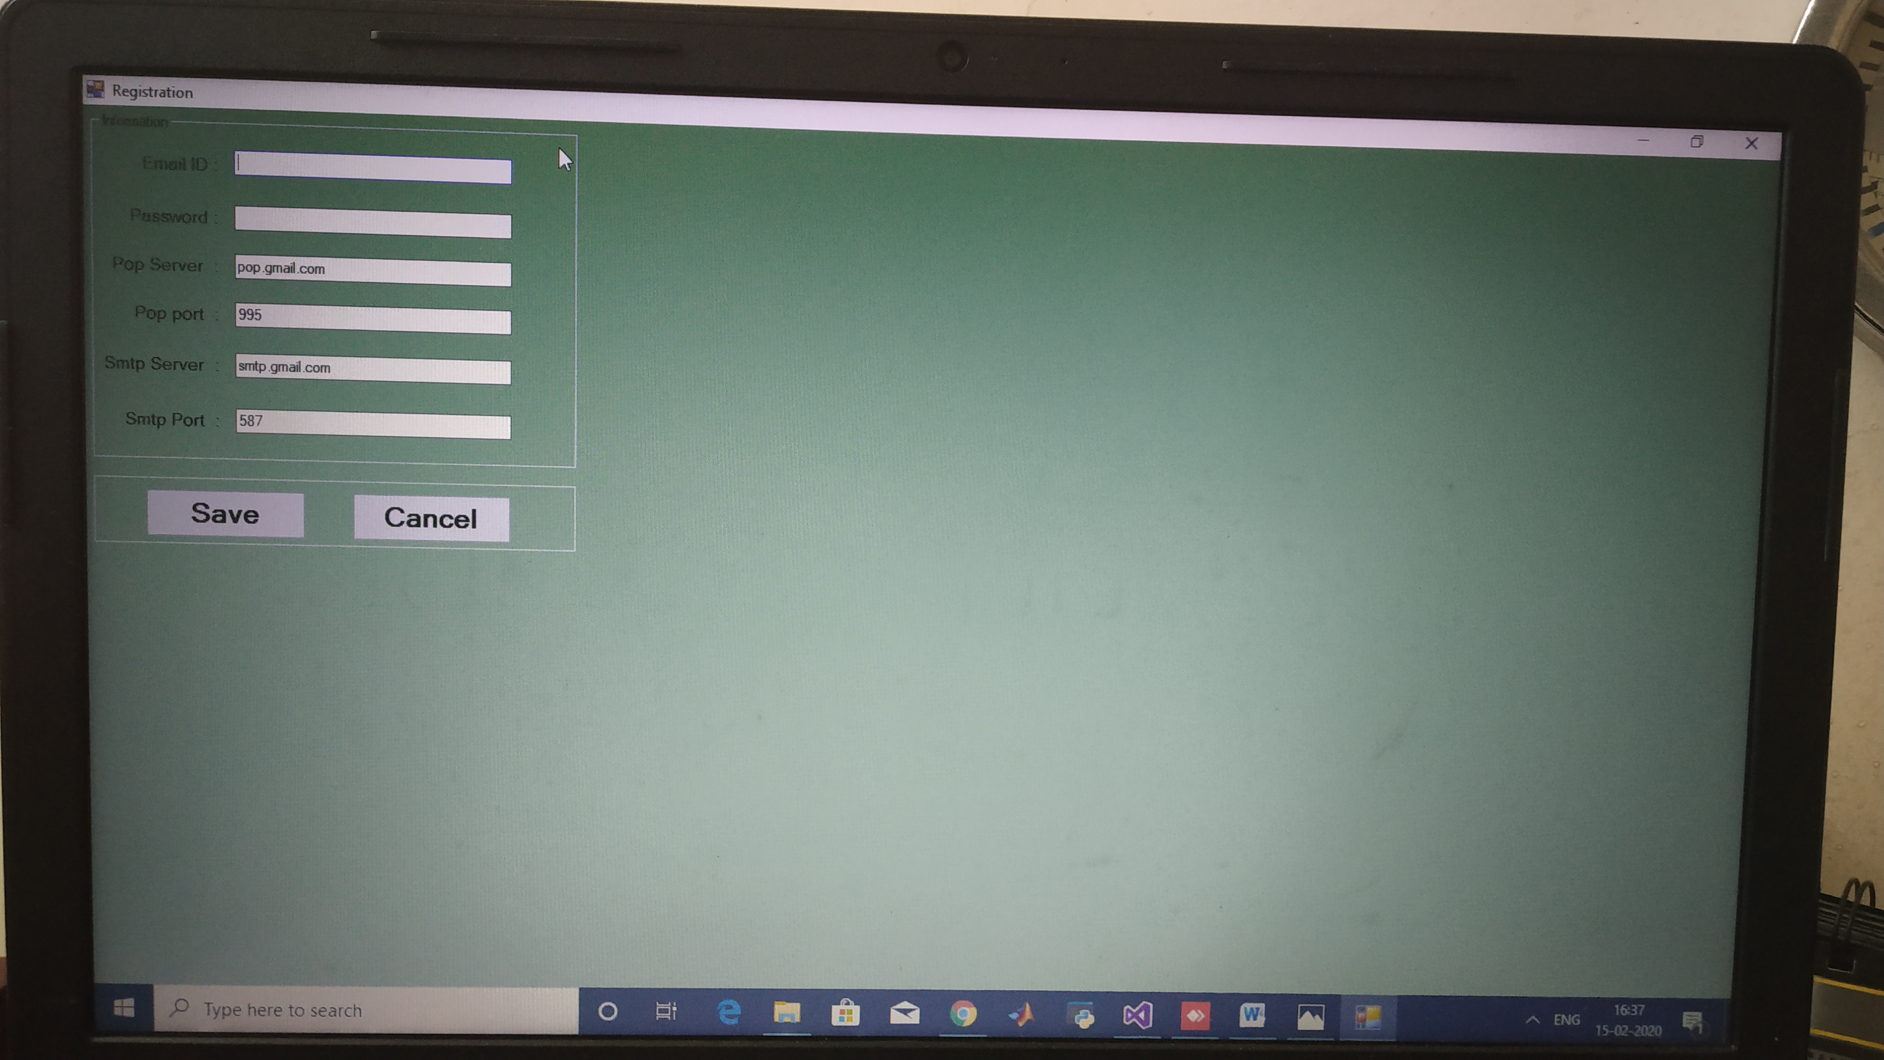
IMPLEMENTATION DETAILS

Slide 6
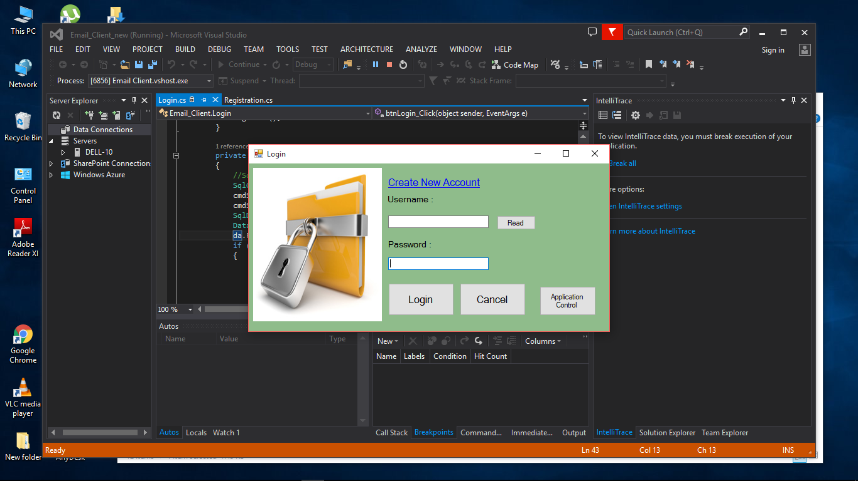
IMPLEMENTATION DETAILS

Slide 7
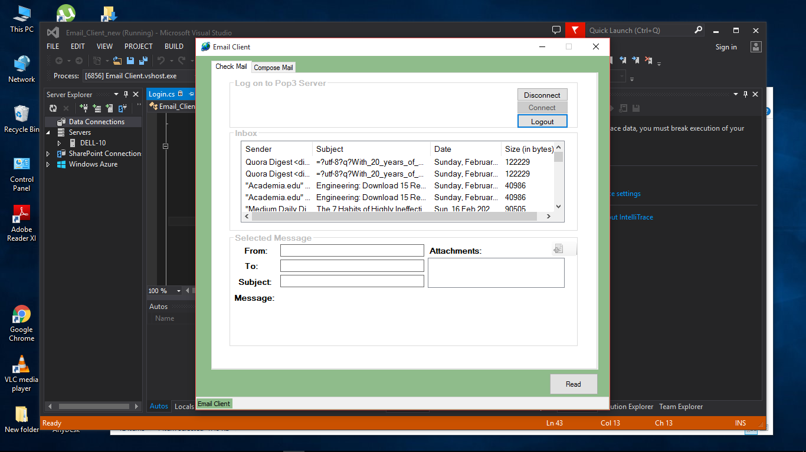
IMPLEMENTATION DETAILS

Slide 8
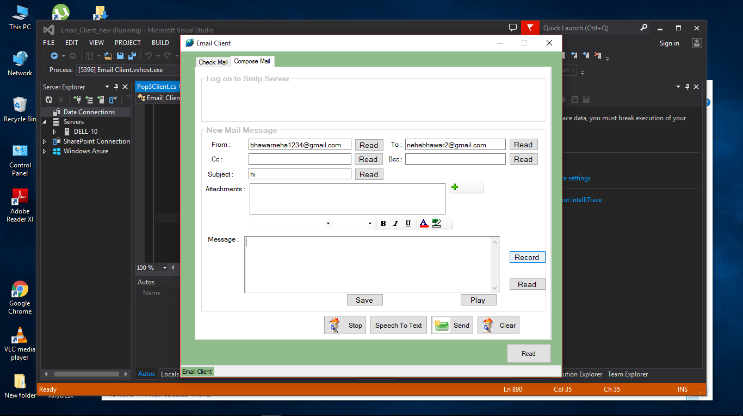
IMPLEMENTATION DETAILS

Slide 9
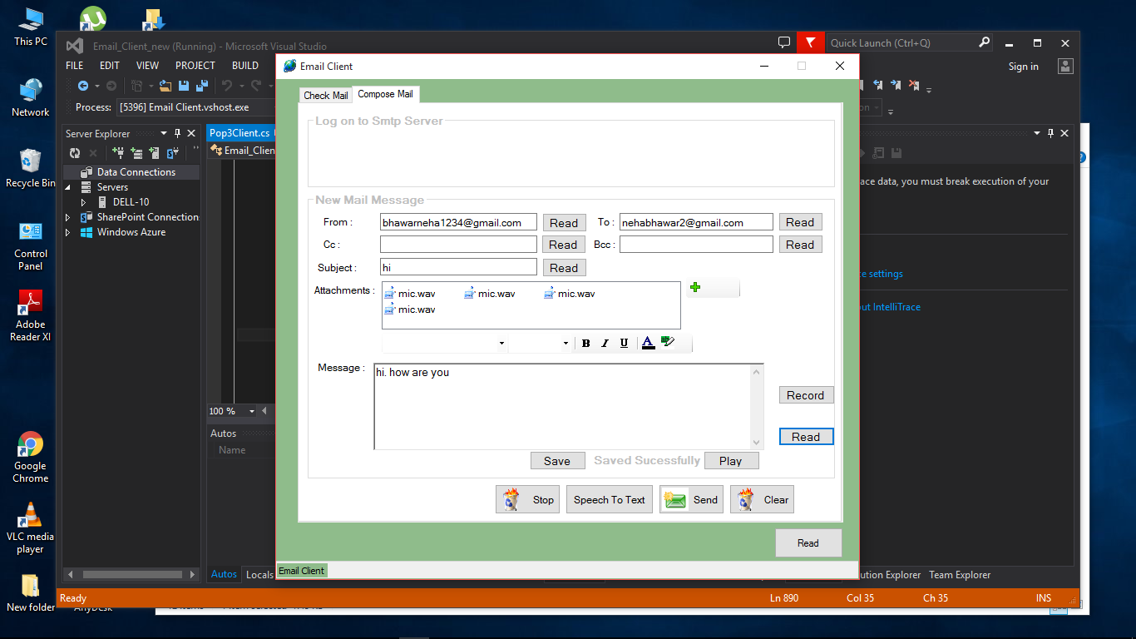
IMPLEMENTATION DETAILS

Slide 10
IMPLEMENTATION DETAILS
Currently working on the training of speech-to-text model so that it catches out accent properly while composing.

Slide 11
CONCLUSION
The main objective is to make the system convenient for the visually impaired without them having to compromise anything.
Project module is running fine.
The current system doesn’t provide all the expected features and have some security issues.
The speech to text part is challenging so we had to make use of keyboard at some points.

Slide 12
REFERENCES
Arcjournals.org. (2019). [online] Available at: https://www.arcjournals.org/pdfs/ijrscse/v3-i1/5.pdf [Accessed 11 Sep. 2019].
Ijariit.com. (2019). [online] Available at: https://www.ijariit.com/manuscripts/v3i3/V3I3-1462.pdf [Accessed 11 Sep. 2019].

